Slide 1

RESTAURANT AND CONSUMER DATA
Presented By
Yallapragada Anusha
Shaik Hura Parveen

Slide 2


Slide 3
INTRODUCTION
This project focuses on designing a Restaurant Database System using SQL.
The database stores information about consumers, restaurants, cuisines, preferences, and ratings.
Multiple tables are connected using primary and foreign keys to maintain data consistency.
Various SQL concepts such as WHERE, JOINs, subqueries, CTEs, views, window functions, and stored procedures are used.
The goal is to analyze customer behavior, restaurant performance, and cuisine popularity.

Slide 4

OBJECTIVE
To design a structured Restaurant Database System using SQL.
To store and manage restaurant, consumer, cuisine, and rating data efficiently.
To maintain data integrity using primary and foreign key relationships.
To analyze customer behavior and spending patterns using SQL queries.
To evaluate restaurant performance based on ratings and reviews.
To identify top-rated restaurants and popular cuisines for decision-making.

Slide 5
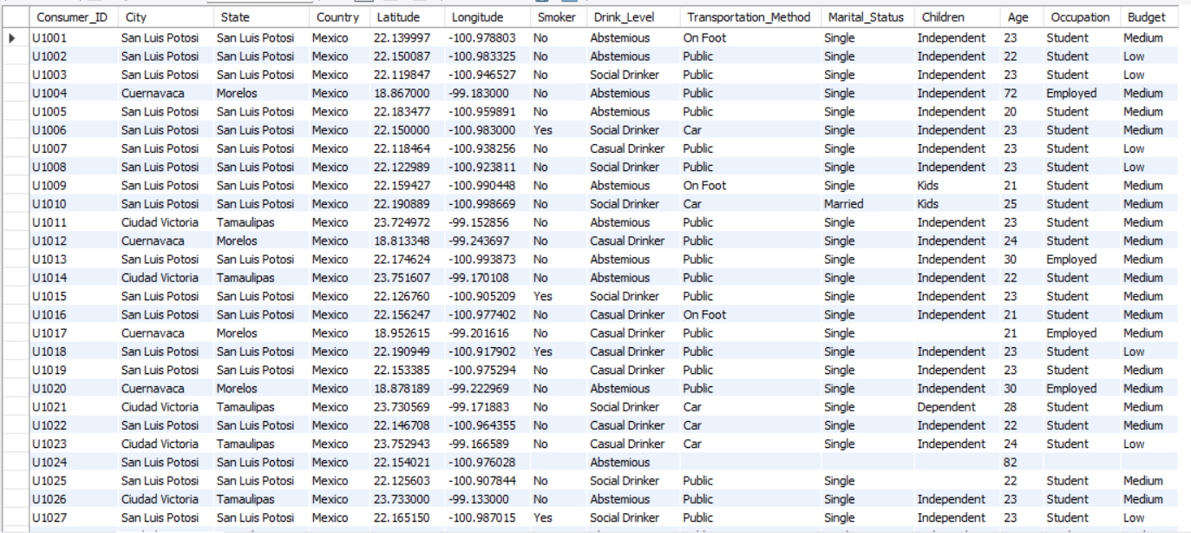


CONSUMERS TABLE

Slide 6
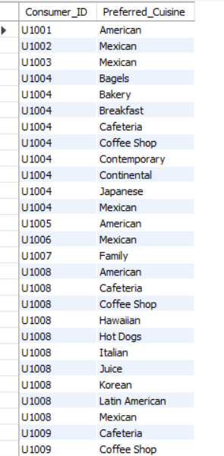

CONSUMER_PREFERENCES TABLE

Slide 7
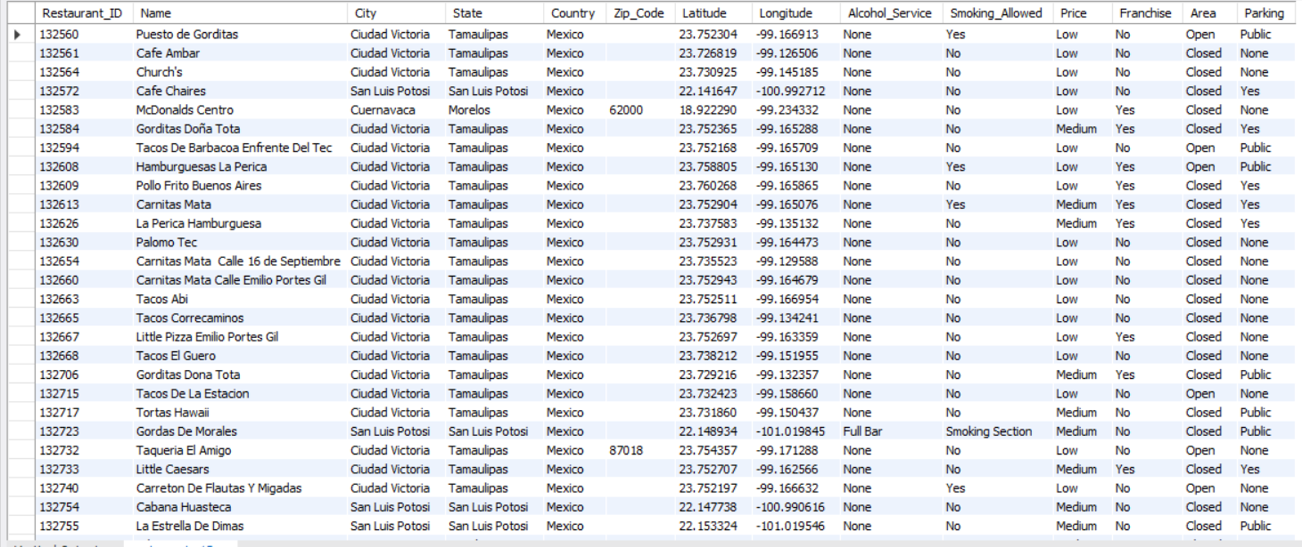

RESTAURANTS TABLE

Slide 8
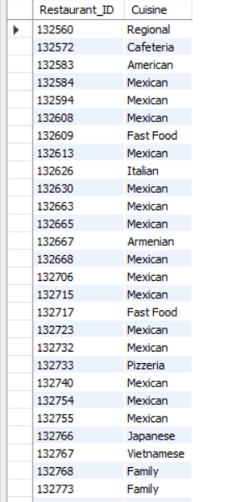
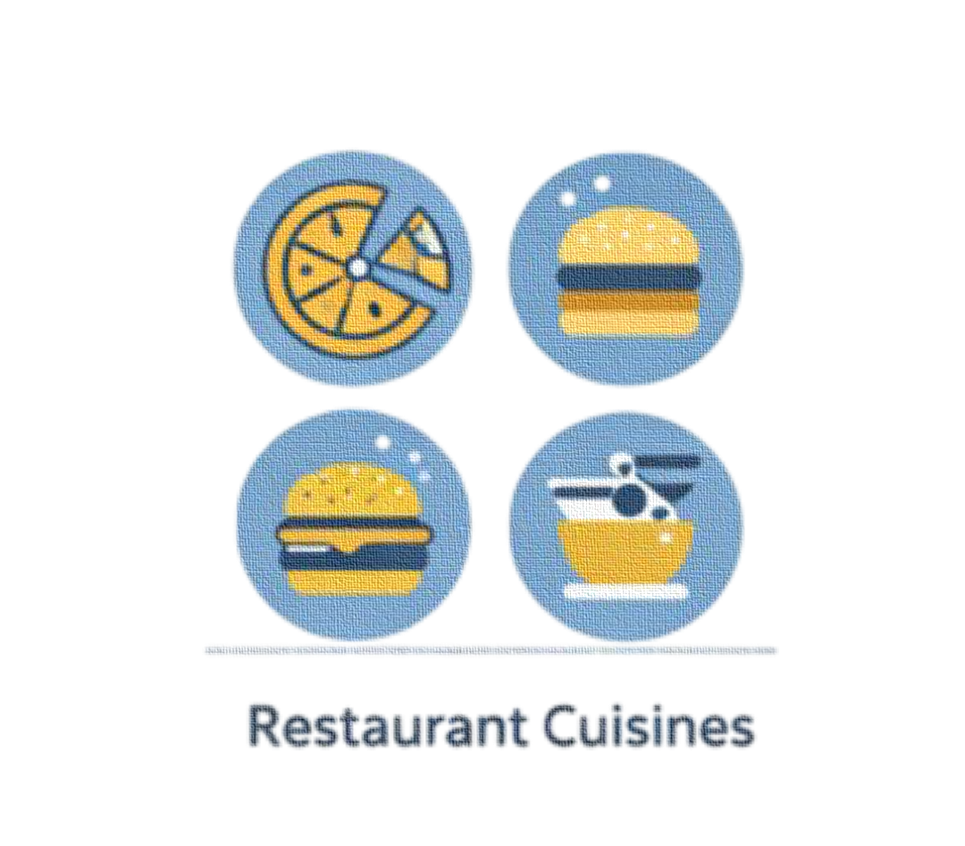
RESTAURANT CUISINES TABLE

Slide 9

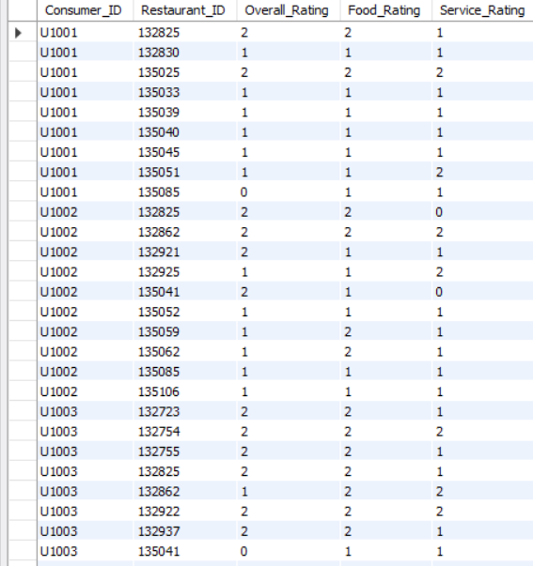
RATINGS TABLE

Slide 10
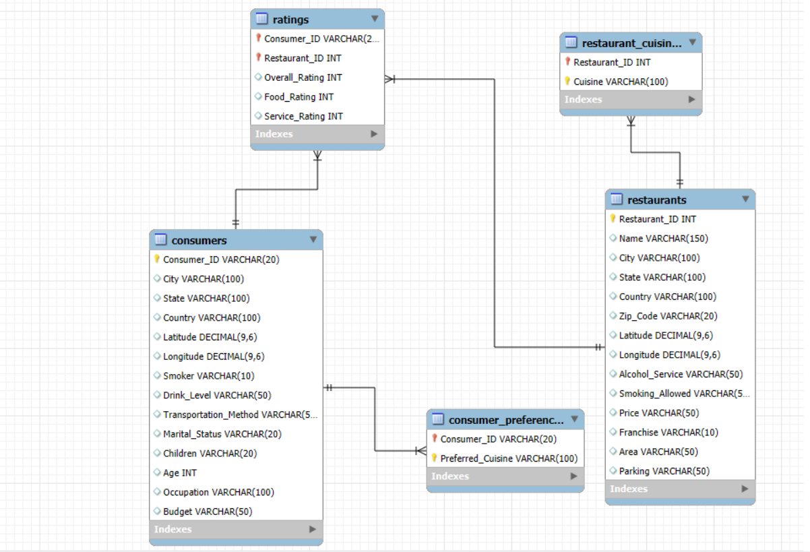
ER - DIAGRAM

Slide 11
PROBLEM STATEMENT
Restaurants generate large volumes of data related to customers, cuisines, locations, and ratings.
Managing this data manually makes it difficult to analyze customer preferences and restaurant performance.
There is a need for a well-structured relational database to store and organize this information efficiently.
The system should support complex queries to extract meaningful insights such as top-rated restaurants, consumer behavior, and cuisine popularity.
Hence, this project aims to design and implement a Restaurant Database System using SQL for effective data analysis and decision-making.

Slide 12
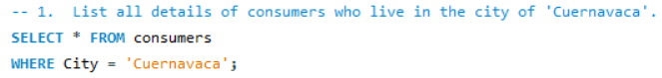
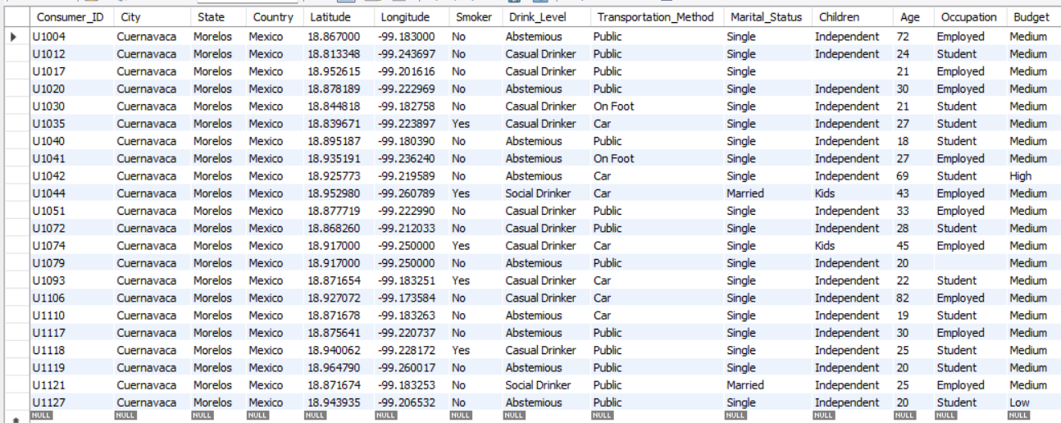
1. List all details of consumers who live in the city of 'Cuernavaca'.

Slide 13
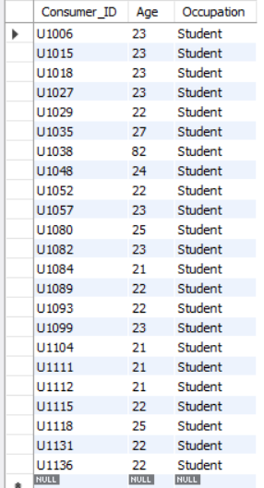
2. Find the Consumer_ID, Age, and Occupation of all consumers who are 'Students' AND are 'Smokers'.

Slide 14
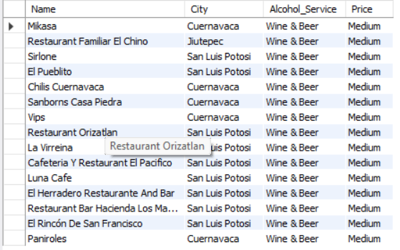
3. List the Name, City, Alcohol_Service, and Price of all restaurants that serve 'Wine & Beer' and have a 'Medium' price level.

Slide 15
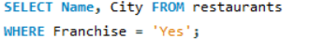
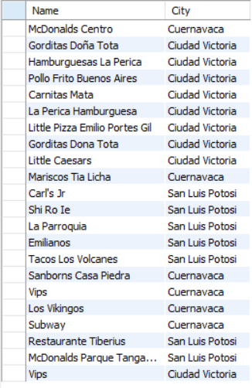

4. Find the names and cities of all restaurants that are part of a 'Franchise'.

Slide 16
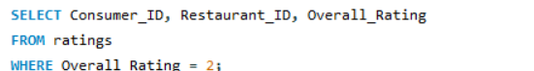
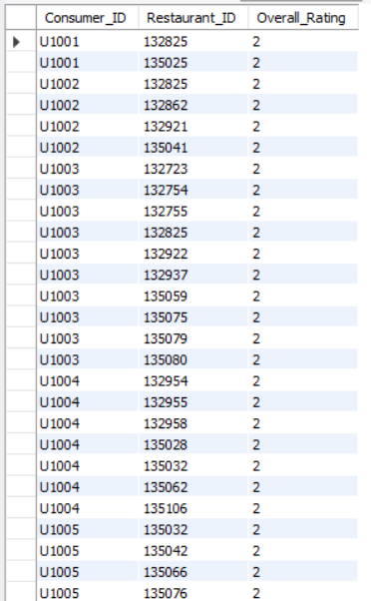
5. Show the Consumer_ID, Restaurant_ID, and Overall_Rating for all ratings where the Overall_Rating was 'Highly Satisfactory' (which corresponds to a value of 2, according to the data dictionary).

Slide 17
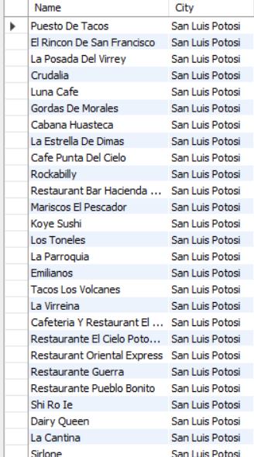
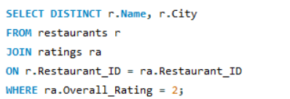
6. List the names and cities of all restaurants that have an Overall_Rating of 2 (Highly Satisfactory) from at least one consumer.

Slide 18
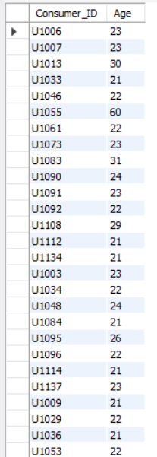
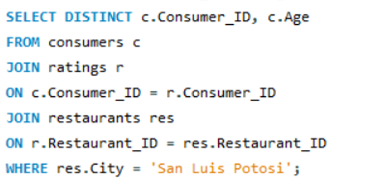
7. Find the Consumer_ID and Age of consumers who have rated restaurants located in 'San Luis Potosi'.

Slide 19
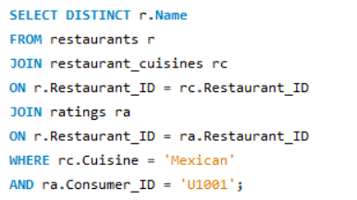
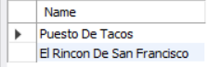
8. List the names of restaurants that serve 'Mexican' cuisine and have been rated by consumer 'U1001'.

Slide 20
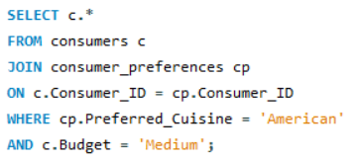
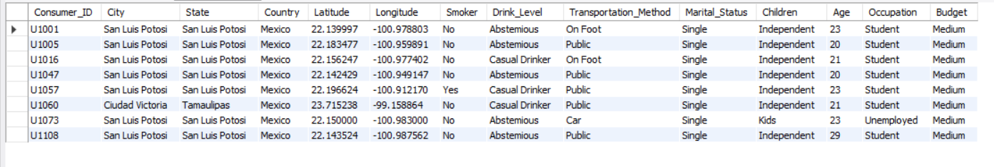
9. Find all details of consumers who prefer 'American' cuisine AND have a 'Medium' budget.

Slide 21
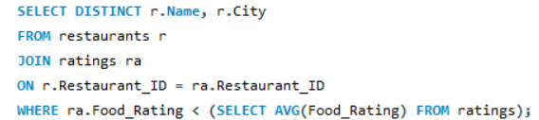
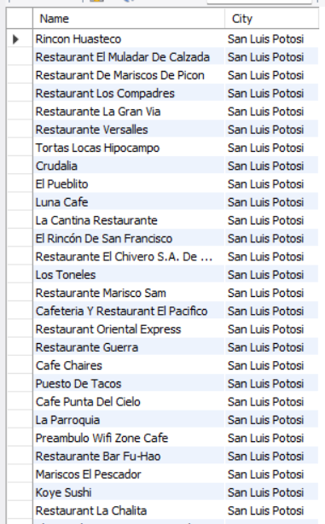
10. List restaurants (Name, City) that have received a Food_Rating lower than the average Food_Rating across all rated restaurants.

Slide 22
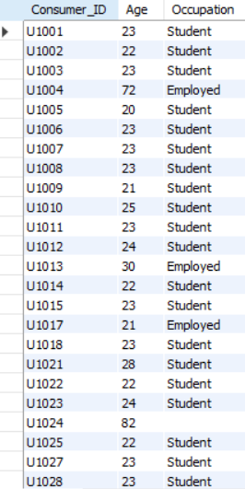
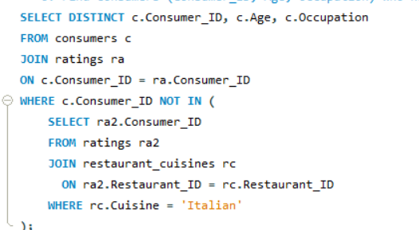
11. Find consumers (Consumer_ID, Age, Occupation) who have rated at least one restaurant but have NOT rated any restaurant that serves 'Italian' cuisine.

Slide 23
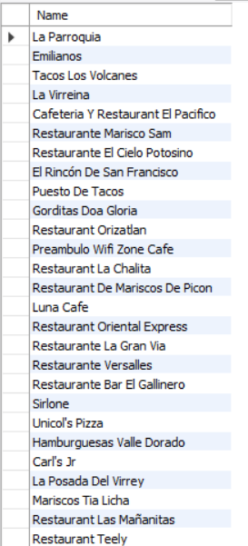
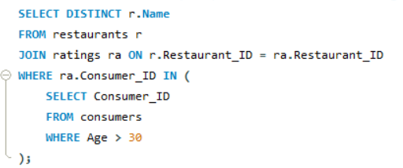
12. List restaurants (Name) that have received ratings from consumers older than 30.

Slide 24
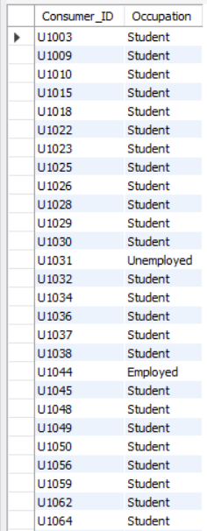
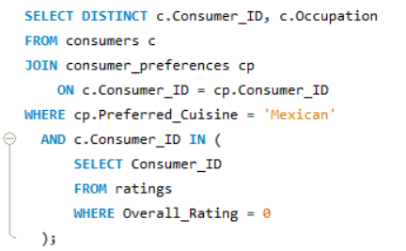
13. Find the Consumer_ID and Occupation of consumers whose preferred cuisine is 'Mexican' and who have given an Overall_Rating of 0 to at least one restaurant (any restaurant).

Slide 25
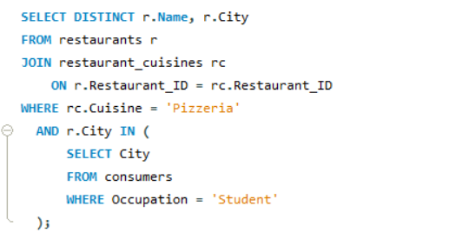
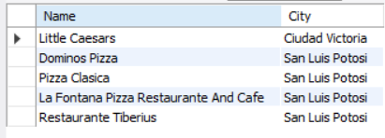
14. List the names and cities of restaurants that serve 'Pizzeria' cuisine and are located in a city where at least one 'Student' consumer lives.

Slide 26
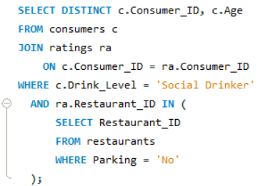
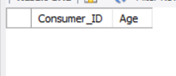
15. Find consumers (Consumer_ID, Age) who are 'Social Drinkers' and have rated a restaurant that has 'No' parking.

Slide 27
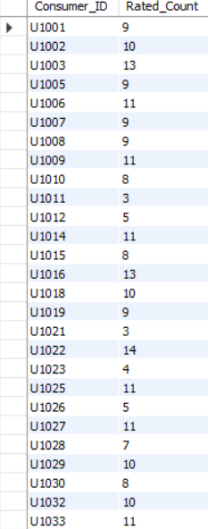
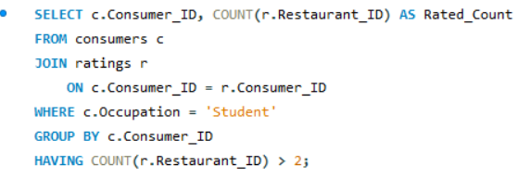
16. List Consumer_IDs and the count of restaurants they've rated, but only for consumers who are 'Students'. Show only students who have rated more than 2 restaurants.

Slide 28
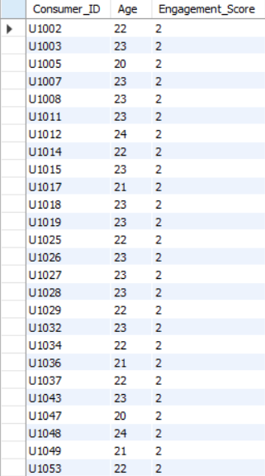
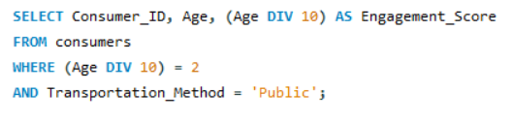
17. We want to categorize consumers by an 'Engagement_Score' which is their Age divided by 10 (integer division). List the Consumer_ID, Age, and this calculated Engagement_Score, but only for consumers whose Engagement_Score would be exactly 2 and who use 'Public' transportation.

Slide 29
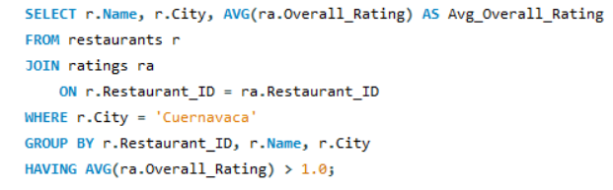
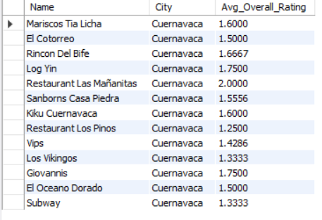
18. For each restaurant, calculate its average Overall_Rating. Then, list the restaurant Name, City, and its calculated average Overall_Rating, but only for restaurants located in 'Cuernavaca' AND whose calculated average Overall_Rating is greater than 1.0.

Slide 30
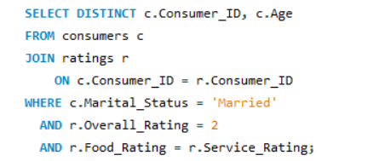
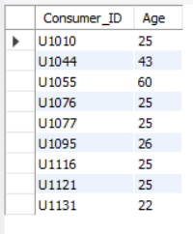
19. Find consumers (Consumer_ID, Age) who are 'Married' and whose Food_Rating for any restaurant is equal to their Service_Rating for that same restaurant, but only consider ratings where the Overall_Rating was 2.

Slide 31
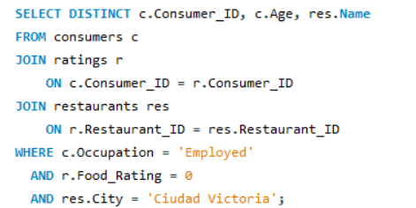
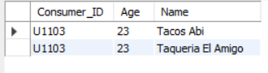
20. List Consumer_ID, Age, and the Name of any restaurant they rated, but only for consumers who are 'Employed' and have given a Food_Rating of 0 to at least one restaurant located in 'Ciudad Victoria'.

Slide 32
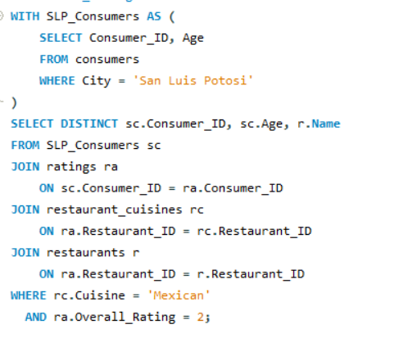
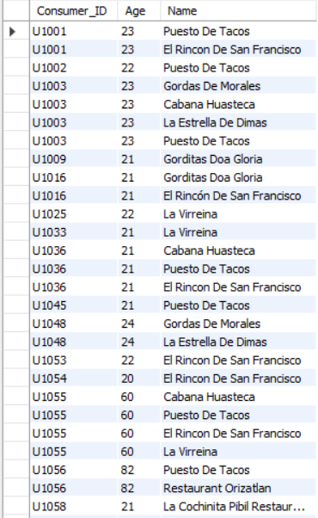
21. Using a CTE, find all consumers who live in 'San Luis Potosi'. Then, list their Consumer_ID, Age, and the Name of any Mexican restaurant they have rated with an Overall_Rating of 2.

Slide 33
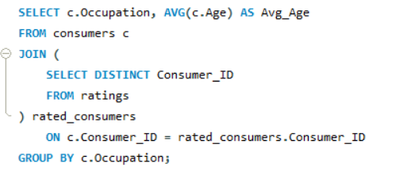
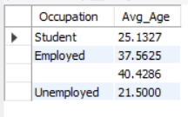
22. For each Occupation, find the average age of consumers. Only consider consumers who have made at least one rating. (Use a derived table to get consumers who have rated).

Slide 34
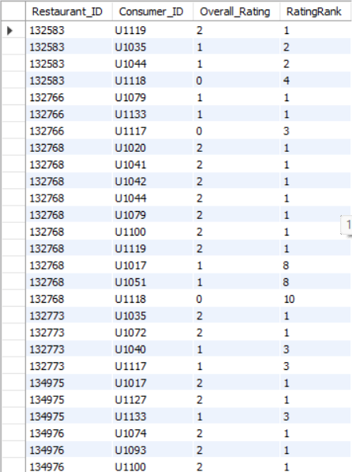

23. Using a CTE to get all ratings for restaurants in 'Cuernavaca', rank these ratings within each restaurant based on Overall_Rating (highest first). Display Restaurant_ID, Consumer_ID, Overall_Rating, and the RatingRank.

Slide 35


24. For each rating, show the Consumer_ID, Restaurant_ID, Overall_Rating, and also display the average Overall_Rating given by that specific consumer across all their ratings.

Slide 36


25. Using a CTE, identify students who have a 'Low' budget. Then, for each of these students, list their top 3 most preferred cuisines based on the order they appear in the Consumer_Preferences table (assuming no explicit preference order, use Consumer_ID, Preferred_Cuisine to define order for ROW_NUMBER).

Slide 37


26. Consider all ratings made by 'Consumer_ID' = 'U1008'. For each rating, show the Restaurant_ID, Overall_Rating, and the Overall_Rating of the next restaurant they rated (if any), ordered by Restaurant_ID (as a proxy for time if rating time isn't available). Use a derived table to filter for the consumer's ratings first.

Slide 38


27. Create a VIEW named HighlyRatedMexicanRestaurants that shows the Restaurant_ID, Name, and City of all Mexican restaurants that have an average Overall_Rating greater than 1.5.

Slide 39


28. First, ensure the HighlyRatedMexicanRestaurants view from Q7 exists. Then, using a CTE to find consumers who prefer 'Mexican' cuisine, list those consumers (Consumer_ID) who have not rated any restaurant listed in the HighlyRatedMexicanRestaurants view.

Slide 40


29. Create a stored procedure GetRestaurantRatingsAboveThreshold that accepts a Restaurant_ID and a minimum Overall_Rating as input. It should return the Consumer_ID, Overall_Rating, Food_Rating, and Service_Rating for that restaurant where the Overall_Rating meets or exceeds the threshold.

Slide 41


30. Identify the top 2 highest-rated (by Overall_Rating) restaurants for each cuisine type. If there are ties in rating, include all tied restaurants. Display Cuisine, Restaurant_Name, City, and Overall_Rating.

Slide 42


31. First, create a VIEW named ConsumerAverageRatings that lists Consumer_ID and their average Overall_Rating. Then, using this view and a CTE, find the top 5 consumers by their average overall rating. For these top 5 consumers, list their Consumer_ID, their average rating, and the number of 'Mexican' restaurants they have rated.

Slide 43
32. Create a stored procedure named GetConsumerSegmentAndRestaurantPerformance that accepts a Consumer_ID as input. The procedure should:
1.Determine the consumer's "Spending Segment" based on their Budget:
'Low' -> 'Budget Conscious’
'Medium' -> 'Moderate Spender’
'High' -> 'Premium Spender’
NULL or other -> 'Unknown Budget’
2. For all restaurants rated by this consumer:
List the Restaurant_Name.
The Overall_Rating given by this consumer.
The average Overall_Rating this restaurant has received from all consumers (not just the input consumer).
A "Performance_Flag" indicating if the input consumer's rating for that restaurant is 'Above Average', 'At Average', or 'Below Average' compared to the restaurant's overall average rating. o Rank these restaurants for the input consumer based on the Overall_Rating they gave (highest rating = rank 1).

Slide 44





Slide 45
CONCLUSION
The Restaurant & Consumer Data Project successfully demonstrates how raw data can be transformed into valuable insights using SQL. By working with multiple related tables, the project highlights the importance of understanding entity relationships and using SQL queries effectively to answer real-world business questions.
Through the use of WHERE clauses, JOINs, subqueries, CTEs, views, window functions, and stored procedures, the project covers both basic and advanced SQL concepts. It enables analysis of consumer preferences, restaurant ratings, spending behavior, and overall performance trends. The queries written in this project reflect practical use cases such as customer segmentation, restaurant ranking, and performance comparison.
Overall, this project strengthens problem-solving skills, improves SQL proficiency, and provides hands-on experience in working with relational databases, making it a valuable learning experience for real-world data-driven applications.

Slide 46

THANK YOU

